Slide 1
Using OpenStack With OpenDaylight
Kyle Mestery, Cisco
Ryan Moats, IBM
Brent Salisbury, Red Hat
Madhu Venugopal, Red Hat
2-5-2014

Slide 2
What You Will Walk Away With
Hands on experience bringing up OpenDaylight on Fedora
Hands on experience bringing up a multi-node OpenStack environment
Hands on experience using OpenDaylight with OpenStack Neutron for virtual tenant networks

Slide 3



Neutron
Controller
ML2 Plug-In
OpenDaylight NorthBound API Layer - REST APIs
OpenDaylight Neutron REST-API
OVSDB Neutron Application
API Driven SAL (ADSAL)
Model Driven SAL (MDSAL)
Configuration
Service
Inventory
Service
Connection
Service
Flow
Programmer
Inventory
Service
Connection
Service
Flow
Programmer
OVSDB South-bound Plugin
OpenFlow 1.0 SB Plugin
OpenFlow 1.3 SB Plugin
OVSDB Protocol Library
OpenFlow 1.0 Plugin
OpenFlow 1.3 Plugin
Bidirectional JSON-RPC Library
OpenFlow 1.0 Library
OpenFlow 1.3 Library
Netty.io
java.nio.socket
Netty io
OpenFlow 1.0
OpenFlow1.3
OVSDB Protocol
OpenVSwitch

Slide 4
What You Will Need
OpenDaylight Virtualization Edition with OVSDB
  Can be in a VM or on your laptop directly
Two or more OpenStack Nodes
  One node running control software and optionally compute services
  One or more compute nodes

Slide 5
Logistics
The Fedora20 VM has the following information:
  Users:
    root/password
    odl/odl
  Setup for DHCP for the image itself.

Slide 6
Boot Your VM Images
Boot the VM which you will run OpenDaylight inside of.
  Optionally bring-up OpenDaylight on your laptop natively.
  This will work in either scenario.
Verify IP addresses on your VMs (may require reboots).
  This should be done for all VMs.
  This may change once you import the OVF file.

Slide 7
OpenDaylight Configuration and Startup
Edit your ODL configuration:
  opendaylight/configuration/config.ini (change of.address)
Optionally enable OpenFlow 1.3
  opendaylight/configuration/config.ini (uncomment this)
Bring OpenDaylight to life:
  Handy RUN.sh script
    This contains options for both OpenFlow 1.0 (default) or OpenFlow 1.3 (optional)
Post ODL fixup:
  From OSGI console:
    lb | grep simple
    stop <simple forwarding ID>

Slide 8
OpenStack VM Setup
Copy the VM image twice:
  Once for control and once for compute
On both nodes:
  cd /etc/sysconfig/networking-scripts
  sudo cp ifcfg-eth0 ifcfg-eth1
  Edit ifcfg-eth1 to change interface name
On the control node:
  Login as odl/odl
  Copy local.conf.control to devstack/local.conf
  Edit devstack/local.conf and change IP addresses
On the compute node:
  Login as odl/odl
  Copy local.conf.compute to devstack/local.conf
  Edit devstack/local.conf and change IP addresses

Slide 9
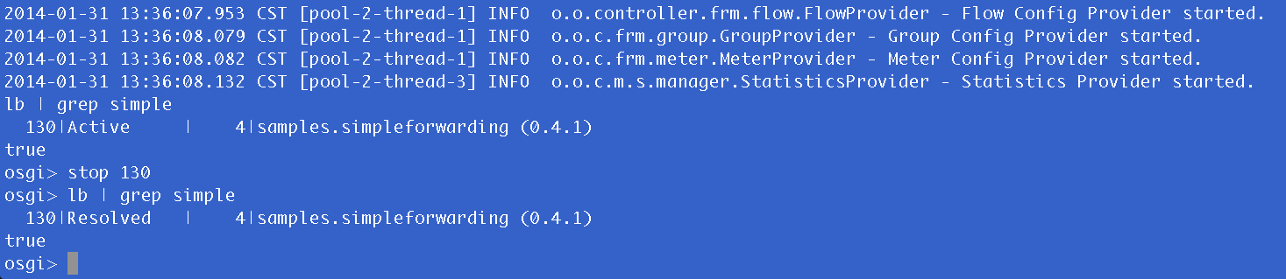
Example of stopping Simple Forwarding

Slide 10
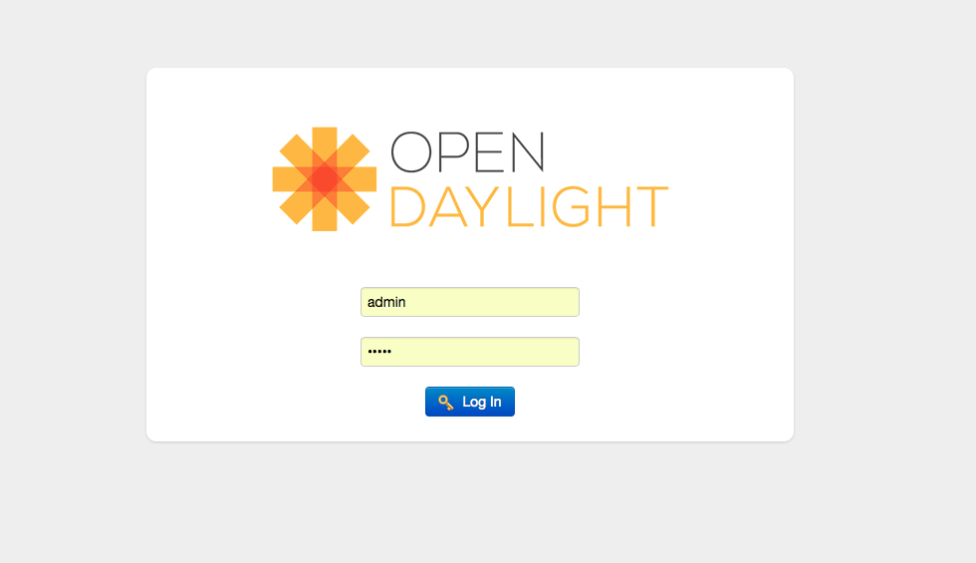
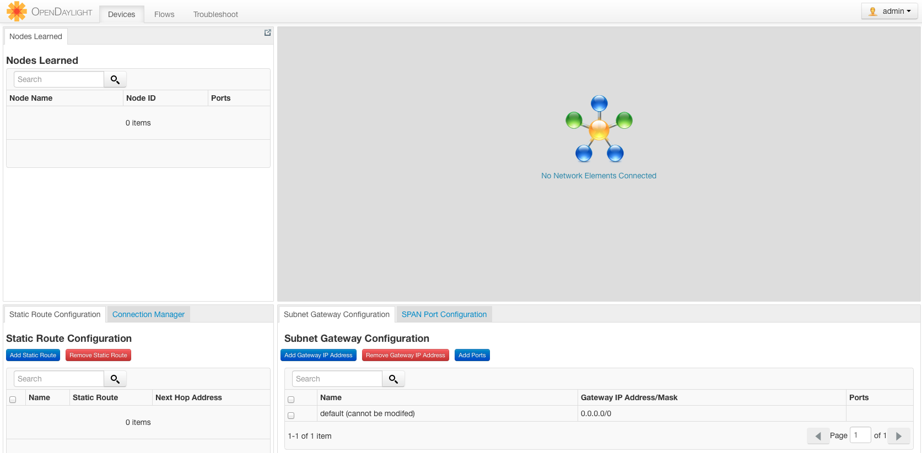
Browse to your ODL Window over HTTP

Slide 11
Boot Up Your OpenStack Instances
Control Node:
  cd devstack
  ./stack.sh
Compute Node:
  cd devstack
  ./stack.sh

Slide 12
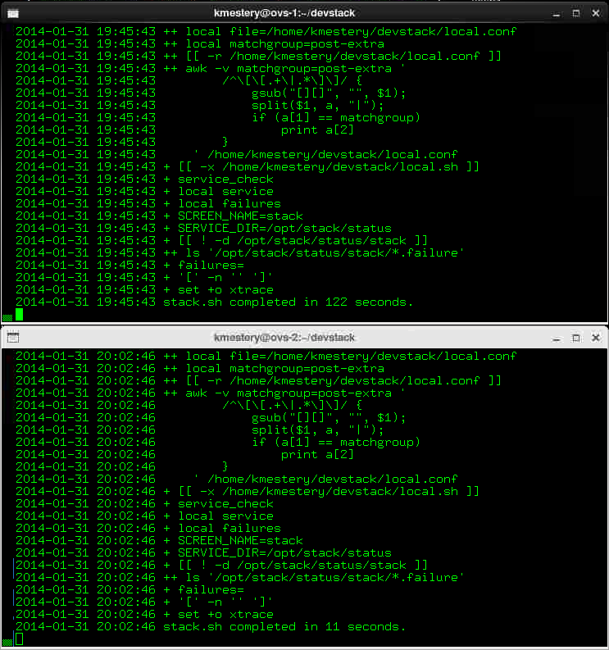
Your devstack will look like this

Slide 13
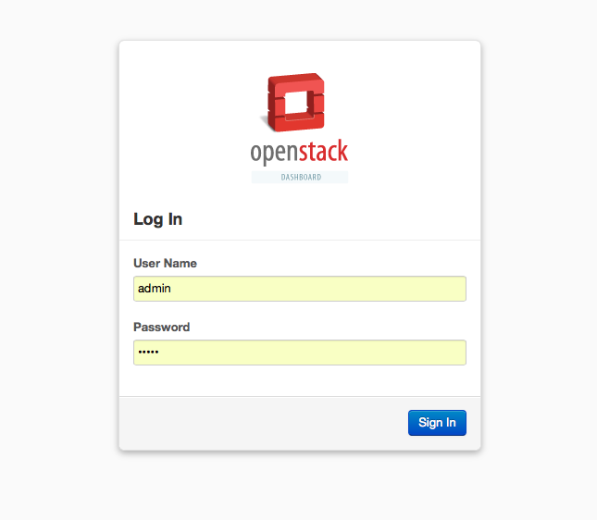
Login to Horizon (go to the IP of your control node)

Slide 14
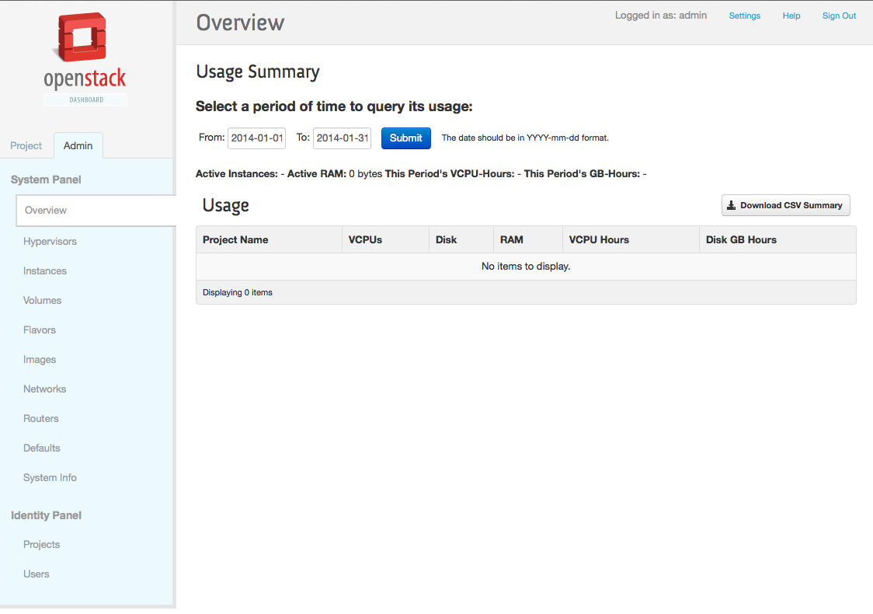
Login as (admin/admin) to see the Horizon Dashboard

Slide 15
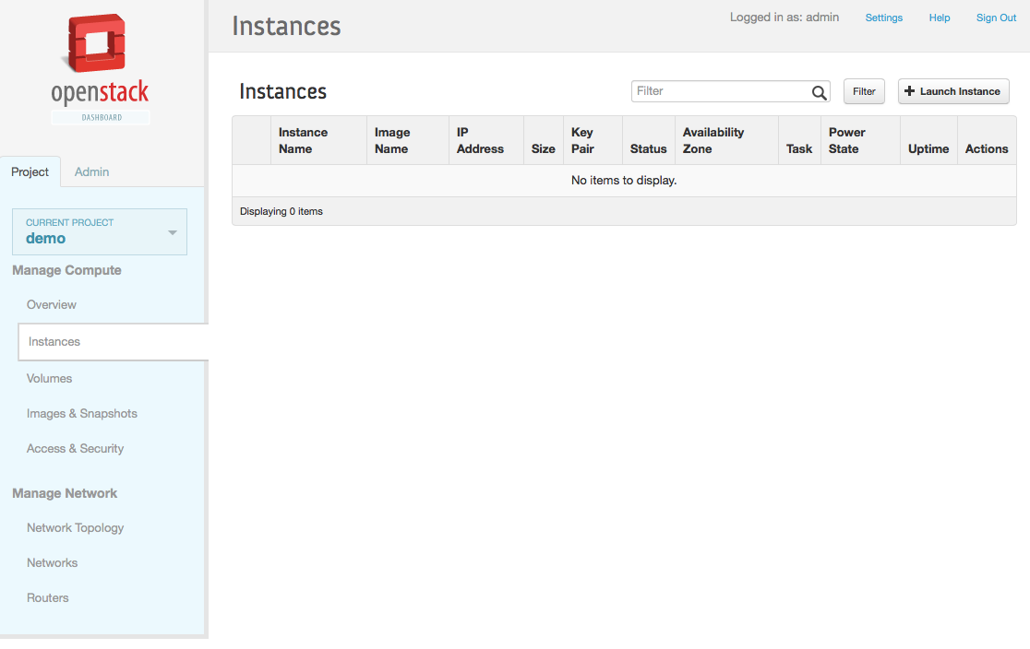
Spinup a VM

Slide 16
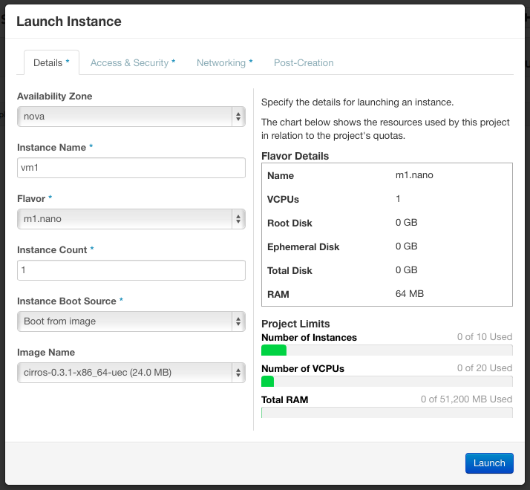
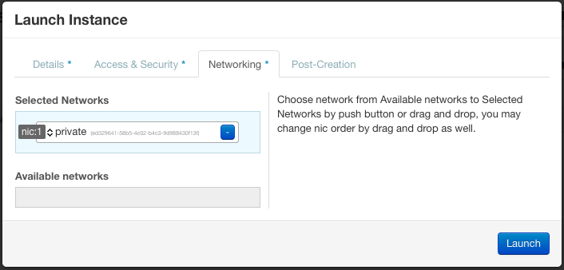
Spinup a VM
(cont.)

Slide 17
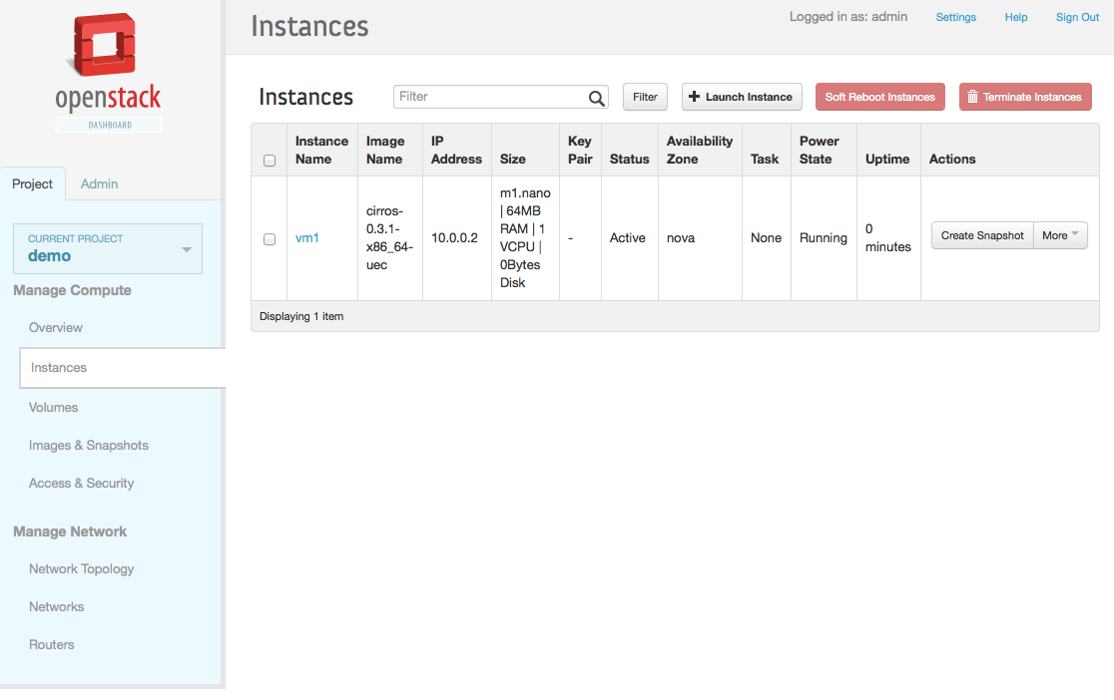
Instance is now booted

Slide 18
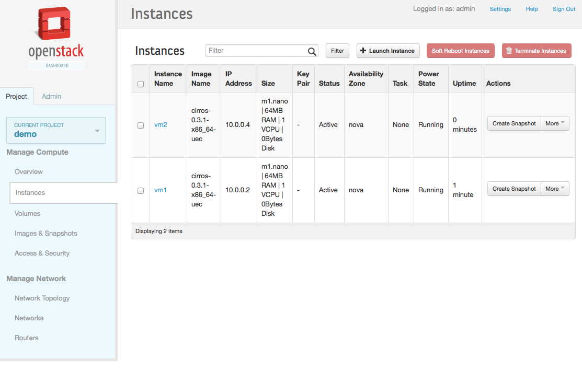
Repeat process for a second VM

Slide 19
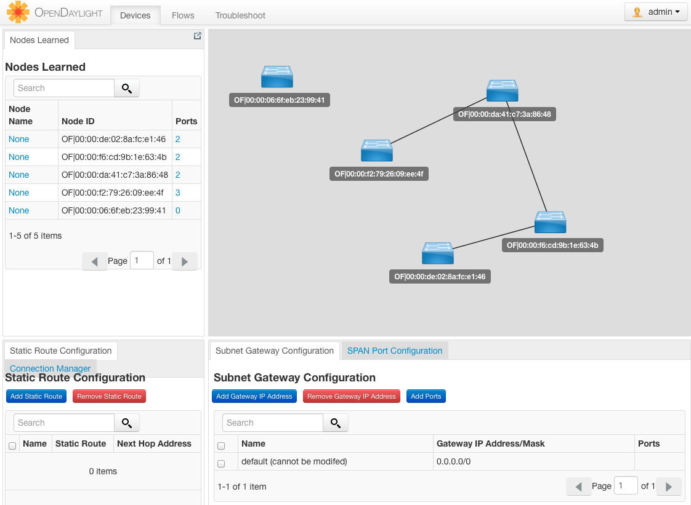
Checkout OpenDaylight Web GUI

Slide 20
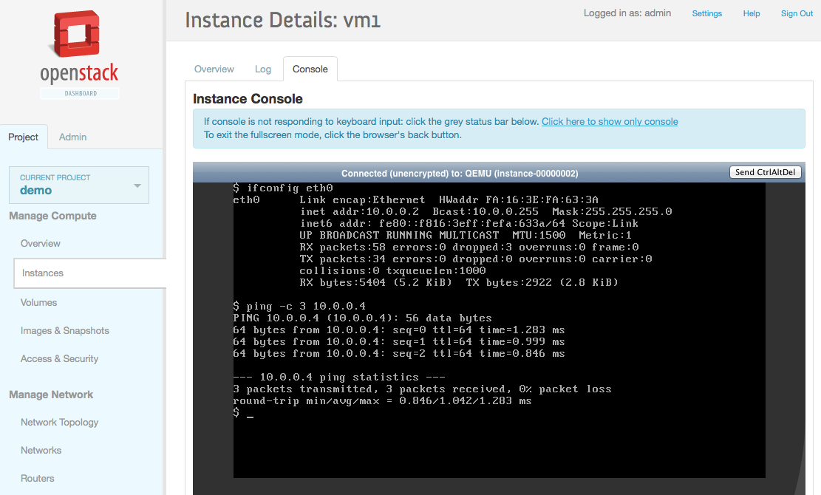
Ping test between VMs

Slide 21
Thank You!

